Slide 1
ACOLAP PRESENTATION
Paul Noland
IAAPA President and CEO

Slide 2
2
AGENDA
About IAAPA
Industry Outlook: Global and Regional
Industry Trends
Questions

Slide 3
About IAAPA
3
Founded in 1918
The largest international trade association for permanently located amusement facilities and attractions
Over 5,000 attraction, supplier, and individual members in 99 countries
Global headquarters is moving to Orlando, FL
Regional offices in Brussels, Hong Kong, Mexico City, and Orlando

Slide 4
4
IAAPA’s Mission
To serve the membership by promoting safe operations, global development, professional growth, and commercial success of the amusement parks and attractions industry.

Slide 5
5
One World, One IAAPA
Global Strategy, Local Services
Expos and Events
Education
Industry Information and Resources

Slide 6
IAAPA LATIN AMERICA
6
Located in Mexico City
Paulina Reyes, Vice President of IAAPA Latin American Operations
www.IAAPA.org/connect/latin-america
E-mail: latinoamerica@IAAPA.org

Slide 7
IAAPA Expos and Events
7
Regional Networking Events
IAAPA Safety Institute
Sept. 11 in Mexico City
Latin American Summit 2018
April 17 – 18 in Costa Rica
IAAPA Expos
Notes:
Stay tunned for more networking and face to face Education.

Slide 8
IAAPA Education
8
Webinars
IAAPA Institutes (In-depth, multi-day learning)
Tools of the Trade
IAAPA Certification Program
Education Program at IAAPA Expos
Learn More: www.IAAPA.org
Notes:
THIS YEAR WE ARE PRESENTING 11 WEBINARS FOR LATIN AMERICA IN SPANISH AND PORTUGUESE.

Slide 9
Connecting the Industry
9
FEC Summit (Family Entertainment Centers)
IAAPA Leadership Conference
IAAPA Latin American Regional Networking Event
IAAPA Expos
Singapore
June13-16,2017
Berlin September 24-27, 2017 2017
Orlando
November 13-17, 2017

Slide 10
IAAPA Information/Resources
10
Funworld Magazine
IAAPA News Flash
Government Relations and Advocacy
Communications and Media Relations Support
Industry Research
Notes:
Emphasis IAAPA research and how important it is for members to respond.
Ride safety report
Amusement park benchmark survey

Slide 11
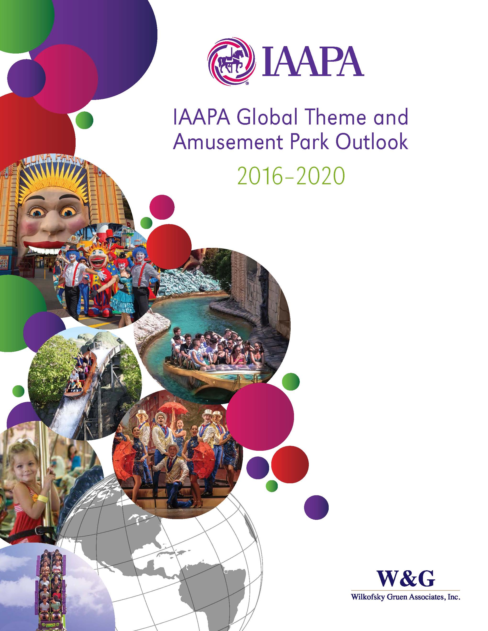
Industry Outlook: Global and Regional
11

Slide 12
12
Notes:
Growth is CAGR

Slide 13
13

Slide 14
14

Slide 15
15
Park Spending Outpacing Nominal GDP Globally
Notes:
Based on 2010 = 100 scale

Slide 16
Principle Global Drivers
16
Rising Investment
Unique Experiences
Intellectual Property
VR Technology
Emerging Middle Class
Dynamic Pricing
Global Tourism Growth

Slide 17
17
Notes:
Growth is CAGR

Slide 18
18

Slide 19
Outlook for Latin America
19
Even though economies in flux:
Large population
Growing middle class
Rising incomes
Steady expansion over next 5 years
Notes:
Acknowledge challenges of economies in South America – remind them our industry tends to be resistant to economic downturns.
Families still want to enjoy quality family time together.

Slide 20
Outlook for Latin America
20
Parks in development in
Guatemala, Costa Rica, Mexico
Small Parks and attractions expected to generate the most growth
FECs continued growth
Water Parks continue growing
Notes:
Cirque du Soleil in Mexico, Project Amikoo: three themed hotels, Convention Center, Museum, two theme parks.
Six Flags Mexico Hurricane Harbor Water Park
We are seeing also Aquariums developments: Acuario Michin in Guadalajara, Aquarium Project in Argentina
Water parks in Colombia and Brazil
Discovery Costa Rica, Adventrure park, will include a Water Park, hotels
Adventure Park in Guatemala Xejuyup
Attractions such as Aquairums: AquaRio, Acuario Michin

Slide 21
Industry Trends in Latin America
21
Immersive experiences
Technology and interactivity
Intellectual Property
Edutainment
Hotels/Resorts
Adventure Parks
Water Parks
Notes:
Immersive experiencies with theming
Technology, from the use of apps to expand the experience to 3D glasess for Roller coasters
Hotels/ resorts: Xcaret is building a hotel, IRTRA, etc.
Adventure Parks like Xejuyup, KidZania
Water Parks:

Slide 22
HS Code Reclassification
Project Advances
22
The attractions equipment import/export code amendment has been formally submitted to the World Custom Organization (WCO)
WCO’s Harmonized System Review Sub-Committee (RSC) is holding a hearing on May 31st in Brussels
We hope to clear the RSC sub-committee in 2017 and move towards a fill WCO vote in 2018.
Notes:
In Spring 2016, after consultation with the Latin American Committee, the global M&S Committee, and the IAAPA Board, IAAPA moved forward with our World Customs Organization (WCO) appeal of the classification of attractions equipment. Currently, attractions equipment is classified as a consumer good in a miscellaneous category in the Toys, Games, and Sporting Goods chapter. This appeal will assign unique HS codes for the import/export of attractions equipment, allow for tracking of global market trends, and clearly designate attractions equipment as capital goods.
• IAAPA submitted an amendment proposal to the US International Trade Commission (US ITC) and the US Customs & Border Patrol as you must have a member country present your proposed amendment. The US ITC agreed to present our case to the WCO.
• The US ITC presented our draft appeal to the WCO’s Harmonized System Review Sub-Committee (RSC) meeting in Brussels in May 2016. The responses were very positive from other delegates and the Secretary-General.
• The delegates from Australia, Canada and Switzerland agreed to help with the final language of the proposal after the May WCO meeting. Additionally, we have received support from the delegates from Japan, China, and Brazil
• The US ITC, with assistance from the other countries, drafted the language of the final appeal and filed it this spring.
• The appeal will be voted on by first the Harmonized System Review Sub-Committee (RSC) in 2017 then the full body of the WCO in 2017 or 2018. Full implementation would be in 2022.

Slide 23
Strong Industry = Strong Association
23
IAAPA is growing to support thriving industry
Increase IAAPA staff in region
Local associations great partners
Our members/volunteers key to success

Slide 24
24
Questions?

